Slide 1
AAF Hidden Genius Visit – July 21st

Slide 2
Agenda
Time | Activities | Attendees /speakers
9:00AM - 10:15AM | Travel to 2623 Camino Ramon | HG staff and students
10:15AM – 11:00 AM | Check in & meet + greet | Melanie, Alexis & Monica
11:00AM – 11:30AM | Speaker 1 – GE overview, diversity etc. | Caleb Moore
11:30AM – 12:30PM | Break + lunch | All
12:30-12:40 | Overview of sessions | Wesley Coats
12:40AM – 1:00PM | Session 1 – Python/Anaconda | Lead: Victor Staff: Jon & Nick
1:00PM – 2:30PM | Session 2 – Machine Learning | Lead: Patrick Staff: Stanley
2:30PM – 3:00PM | Tour – 2623 BLD and DC | Melanie & Alexis (Alexis has DC badge)
3:00PM | Departure | HG staff and students

Slide 3

What’s your favorite coding language?

Slide 4


Sessions
Session 1:
Session 2: Leveraging ML in the NBA
Overview of Session 2 (Wesley)
Python basics w/ manual (Nick/Victor)
Anaconda installation
Data processing
Manual creation (Stanley/Joseph/Patrick/Melanie)
Data pre-processing
Linear Regression Intro
Hand on tutorial data set

Slide 5
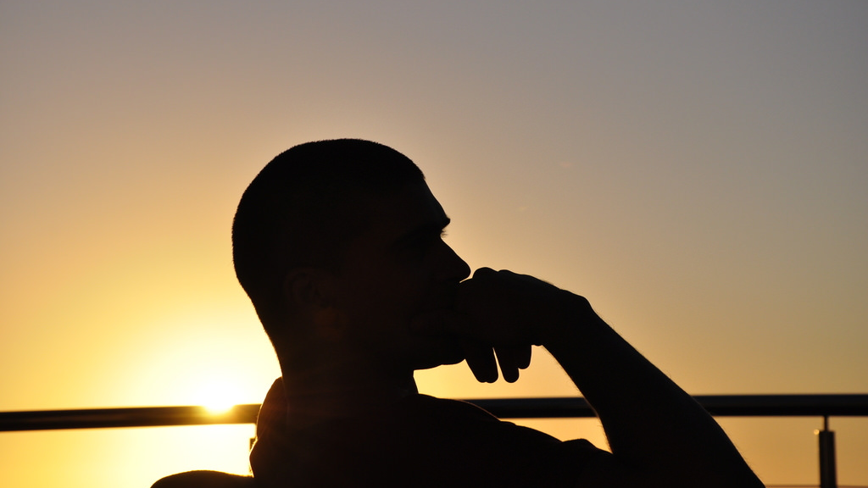
How does these sessions apply to my learning objectives?

